Slide 1
Slim-DP: A Multi-Agent System for Communication-Efficient Distributed Deep Learning
Du Xiao - December, 31th, 2021

Slide 2
Motivation
Due to the limited bandwidth, such frequent communication will cause severe bottleneck for the training acceleration.
Some methods（Quantized Data Parallelism） overlook the effects of compression on the model performance such that they either suffer from a low compression ratio or an accuracy drop.
To reduce communication cost and preserve the accuracy at the same time

Slide 3
Contribution
Propose a novel multi-agent system (MAS) approach, in which the local workers and the parameter server naturally play as separate agents..
Select and transfer a subset of the important gradients or parameters instead of the whole set like Plump-DP.
In order for better exploration, we mix best-response strategy with ϵ-random strategy

Slide 4

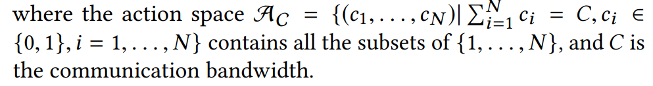
SLIM-DP(action space)
We denote

Slide 5
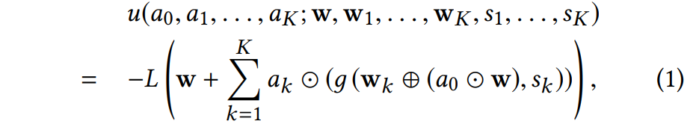
SLIM-DP(Utility)

Slide 6

SLIM-DP
The center agent estimates the utilities of the actions by the total scales of the parameters in corresponding subset.
The local agents estimate the utilities of the actions by the total scales of the gradients in corresponding subset

Slide 7
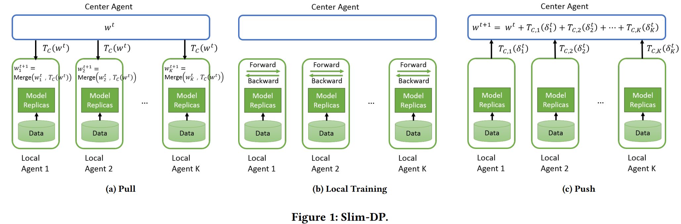
SLIM-DP

Slide 8
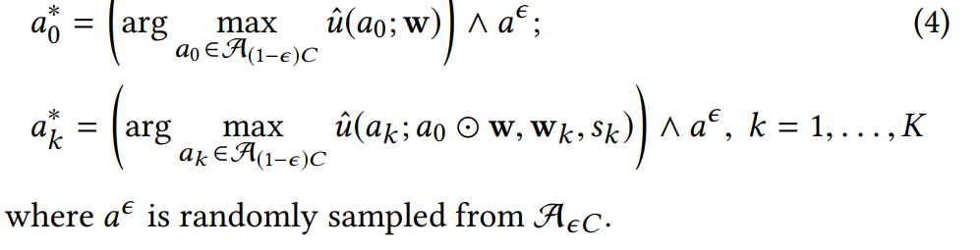
SLIM-DP(explore and exploit)

Slide 9
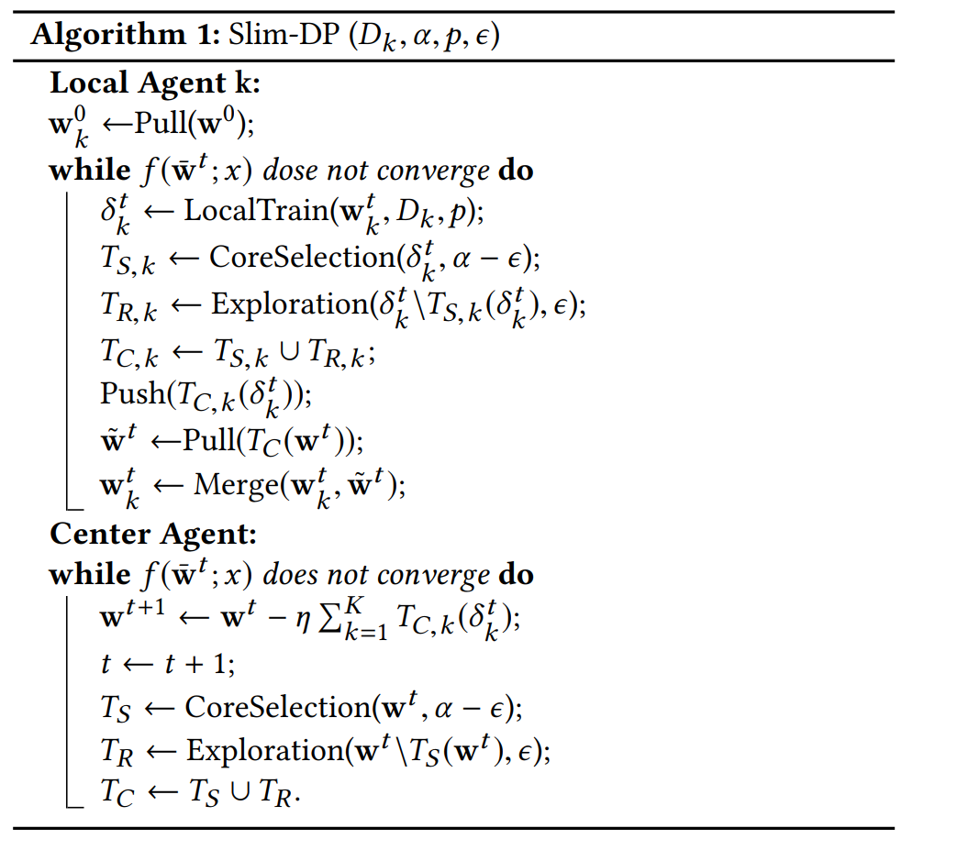
SLIM-DP

Slide 10
Communication and Time efficiency
The communication efficiency can be further improved by executing CoreSelection step after each q rounds of communication (i.e., q > 1) instead of for each round of communication.The reason is that the model will not differ very significantly after recent updates and thus the scale of gradients will not change that fastly when it is computed based on very close model.
The time to generate the index for the explorer and the core. Since it is not related to the scale of the gradientsIt can be executed off-line or overlapped with the gradient computation.

Slide 11
Compared Methods
Plump-DP(Plump Data Parallelism)
Quant-DP(Quantized Data Parallelism)

Slide 12
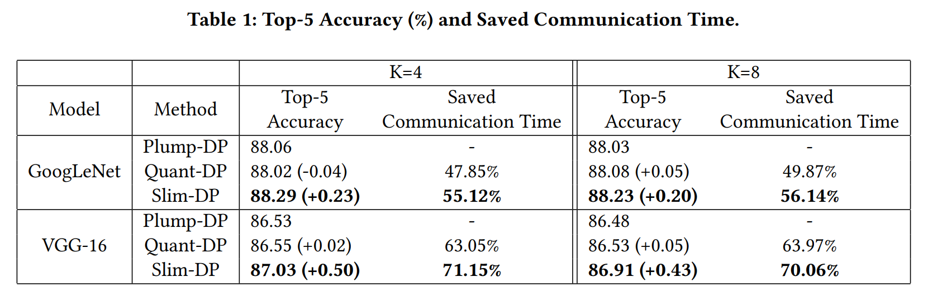
Result(Communication Cost)
Slim-DP can reduce more communication time than Quant-DP

Slide 13
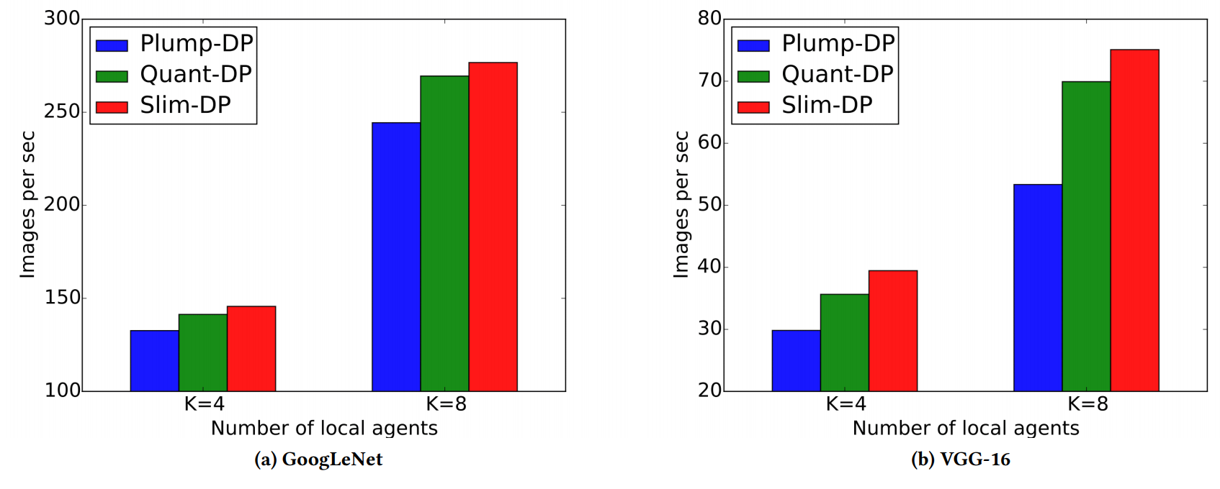
Result(Speed)
Plump-DP can process more images per second than both Plump-DP and Quant-DP.

Slide 14
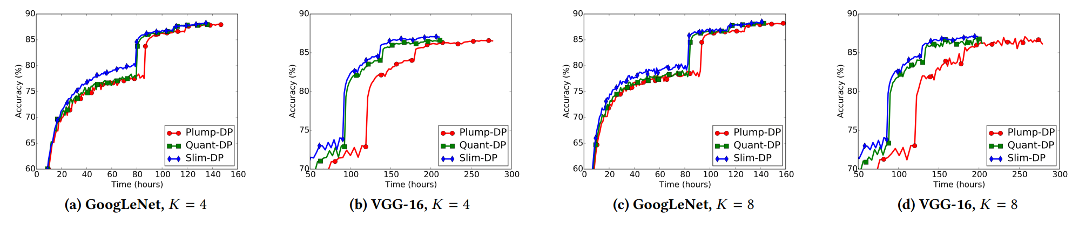
Result(Accuracy)
Slim-DP consistently achieves better performance than both Plump-DP and Quant-DP during the training.

